Slide 1
Tutorial 10
Exploring Arrays, Loops, and Conditional Statements

Slide 2
Objectives
Create an array
Work with array properties and methods
Create a program loop
Work with the for loop
Write comparison and logical operators
Create a conditional statement
Use the if statement

Slide 3
Introducing the Monthly Calendar
Calendar should appear in the form of a web table with links to specific events placed within the table cells
Appearance and placement of the calendar will be set using a CSS style sheet
The program created should be easily adaptable so that it can be used to create other monthly calendars

Slide 4
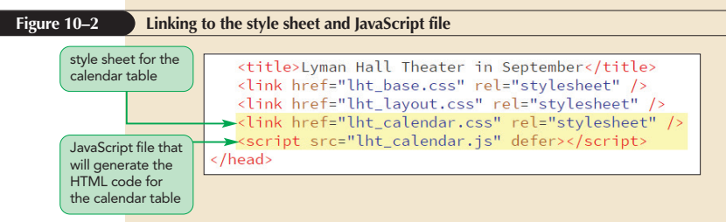
Introducing the Monthly Calendar (continued 1)

Slide 5
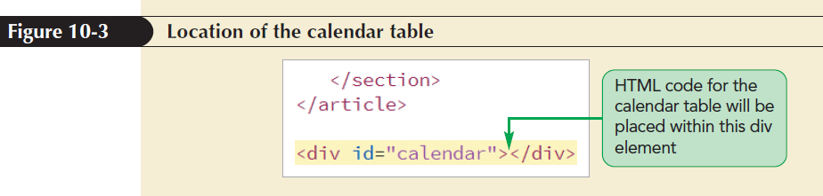
Introducing the Monthly Calendar (continued 2)

Slide 6
Reviewing the Calendar Structure
Names and IDs assigned to the different parts of the table
  Entire calendar is set in a web table with the ID calendar_table
  Cell containing the calendar title has the ID calendar_head
  Seven cells containing the days of the week abbreviations all belong to the class calendar_weekdays

Slide 7
Reviewing the Calendar Structure (continued)
  All cells containing the dates of the month belong to the class calendar_dates
  The cell containing the current date has the ID calendar_today
Class and ID designations make it easier for page developers to assign different styles to the different parts of the calendar

Slide 8
Adding the calendar() Function
Place the commands that generate the calendar within a single function named createCalendar()
Initial code to generate the calendar
  var thisDay = new Date(“September 24, 2021”);
  document.getElementById(“calendar”).innerHTML = createCalendar(thisDay);

Slide 9
Adding the calendar() Function (continued)
  function createCalendar(calDate) {
  var calendarHTML = “<table id='calendar_table'>”;
  calendarHTML += “</table>”;
  return calendarHTML;
  }
thisDay variable: Stores the current date

Slide 10
Introducing Arrays
getMonth() method: Extracts a month number
getFullYear() method: Extracts the four-digit year value
The Date method does not return the name of the month
One way to associate each month number with a month name is by using an array

Slide 11
Introducing Arrays (continued 1)
Array: Collection of values organized under a single name
Index: The number that each individual value is associated with and that distinguishes it from other values in the array
Array values are referenced using the expression array[i]
where array is the name of the array and i is the index of a specific value in the array

Slide 12
Introducing Arrays (continued 2)
Index values start with 0 so that the initial item in an array has an index value of 0
Second item in the array will have an index value of 1, and so on
Example
The expression monthName[4] references the fifth (not the fourth) item in the monthName array

Slide 13
Creating and Populating an Array
To create an array, apply the object constructor
  var array = new Array(length);
  where array is the name of the array and length is the number of items in the array
The length value is optional; if the length parameter is omitted then the array expands automatically as more items are added to it

Slide 14
Creating and Populating an Array (continued 1)
An array can be populated with values by specifying both the array name and the index number of the array item
Command to set the value of a specific item in an array
array[i] = value;
where value is the value assigned to the array item with the index value i

Slide 15
Creating and Populating an Array (continued 2)
Populate the entire array in a single statement using the following command:
  var array = new Array(values);
  where values is a comma-separated list of the values in the array
Example
  var monthName = new Array(“January”, “February”, “March”, “April”, “May”, “June”, “July”, “August”, “September”, “October”, “November”, “December”);

Slide 16
Creating and Populating an Array (continued 3)
Array literal: Creates an array in which the array values are a comma-separated list within a set of square brackets
  var array = [values];
  where values are the values of the array
Example
  var monthName = [“January”, February”, “March”, “April”, “May”, “June”, “July”, “August”, “September”, “October”, “November”, “December”];

Slide 17
Creating and Populating an Array (continued 4)
Array values need not be of the same data type
Mix of numeric values, text strings, and other data types within a single array is allowed
Example
  var x = [“April”, 3.14, true, null];

Slide 18
Working with Array Length
JavaScript array automatically expands in length as more items are added
Apply the following length property to determine the array’s current size:
array.length
where array is the name of the array
Value returned by the length property is equal to one more than the highest index number in the array

Slide 19
Working with Array Length (continued)
Sparse arrays: Created in JavaScript in which some of the array values are undefined
The length value is not always the same as the number of array values
Occurs frequently in database applications
Value of the length property cannot be reduced without removing items from the end of the array

Slide 20
Reversing an Array
Items are placed in an array either in the order in which they are defined or explicitly by index number, by default
JavaScript supports two methods for changing the order of the array items
  reverse()
  sort()
reverse(): Reverses the order of items in an array, making the last items first and the first items last

Slide 21
Sorting an Array
sort(): Rearranges array items in alphabetical order
The sort() method when applied to numeric values will sort the values in order by their leading digits, rather than by their numerical values

Slide 22
Sorting an Array (continued 1)
Compare function: Compares values of two adjacent array items
General form of a compare function is
  function fname(a, b) {
  return a negative, positive, or 0 value
  }
  where fname is the name of the compare function and a and b are parameters that represent a pair of array values

Slide 23
Sorting an Array (continued 2)
Based on comparison of two adjacent array item values, the function returns a negative, positive, or zero value
  If a negative value is returned, then a is placed before b in the array
  If a positive value is returned, then b is placed before a
  If a zero value is returned, a and b retain their original positions

Slide 24
Sorting an Array (continued 3)
Function to sort numeric values in ascending order
  function ascending(a, b) {
  return a - b;
  }
Function to sort numbers in descending order
  function descending(a, b) {
  return b - a;
  }

Slide 25
Sorting an Array (continued 4)
The compare function is applied to the sort() method as follows
  array.sort(fname)
  where fname is the name of the compare function
Example
x.sort(ascending)

Slide 26
Extracting and Inserting Array Items
Subarray: Section of an array
To create a subarray use slice() method
array.slice(start, stop)
  where start is the index value of the array item at which the slicing starts and stop is the index value at which the slicing ends
  The stop value is optional; if it is omitted, the array is sliced to its end

Slide 27
Extracting and Inserting Array Items (continued)
splice(): Removes and inserts array items
array.splice(start, size, values)
start is the starting index in the array, size is the number of array items to remove after the start index, and values is an optional comma-separated list of values to insert into the array
If no values are specified, the splice method simply removes items from the array
Always alters the original array

Slide 28
Using Arrays as Data Stacks
Stack: Arrays can be used to store information in a data structure
New items are added to the top of the stack or to the end of the array
A stack data structure employs the last-in first-out (LIFO) principle
In the LIFO principle the last items added to the stack are the first ones removed

Slide 29
Using Arrays as Data Stacks (continued 1)
push() method: Appends new items to the end of an array
  array.push(values)
  where values is a comma-separated list of values to be appended to the end of the array
pop() method: Removes or unstacks the last item
  array.pop()

Slide 30
Using Arrays as Data Stacks (continued 2)
Queue: Employs the first-in-first-out (FIFO) principle in which the first item added to the data list is the first removed
Similar to a stack
shift() method: Removes the first array item
unshift() method: Inserts new items at the front of the array

Slide 31
Using Arrays as Data Stacks (continued 3)
Method | Description
copyWithin(target, start[, end]) | Copies items within the array to the target index, starting with the start index and ending with the optional end index
concat(array1, array2,...) | Joins the array to two or more arrays, creating a single array containing the items from all the arrays
fill(value[, start][, end]) | Fills the array with items having the value , starting from the start index and ending at the end index
indexOf(value[, start]) | Searches the array, returning the index number of the first element equal to value, starting from the optional start index
join(separator) | Joins all items in the array into a single text string; the array items are separated using the text in the separator parameter; if no separator is specified, a comma is used
lastIndexOf(value[, start]) | Searches backward through the array, returning the index number of the first element equal to value, starting from the optional start index
pop() | Removes the last item from the array
push(values) | Appends the array with new items, where values is a comma-separated list of item values

Slide 32
Using Arrays as Data Stacks (continued 4)
Method | Description
reverse() | Reverses the order of items in the array
shift() | Removes the first item from the array
slice(start, stop) | Extracts the array items starting with the start index up to the stop index, returning a new subarray
array.splice(start, size, values) | Extracts size items from the array starting with the item with the index start; to insert new items into the array, specify the array items in a comma-separated values list
array.sort(fname) | Sorts the array where fname is the name of a function that returns a positive, negative, or 0 value; if no function is specified, array is sorted in alphabetical order
array.toString() | Converts the contents of the array to a text string with the array values in a comma-separated list
array.unshift(values) | Inserts new items at the start of the array, where values is a comma-separated list of new values

Slide 33
Working with Program Loops
Program loop: Set of commands executed repeatedly until a stopping condition is met
Two commonly used program loops in JavaScript are
  for loops
  while loops

Slide 34
Exploring the for Loop
In a for loop, a variable known as a counter variable is used to track the number of times a block of commands is run
When the counter variable reaches or exceeds a specified value, the for loop stops
General structure of a for loop
  for (start; continue; update) {
  commands
  }

Slide 35
Exploring the for Loop (continued 1)
  where start is an expression that sets the initial value of a counter variable
  continue is a Boolean expression that must be true for the loop to continue
  update is an expression that indicates how the value of the counter variable should change each time through the loop
  commands are the JavaScript statements that are run for each loop

Slide 36
Exploring the for Loop (continued 2)
Command block: Set of commands that is run each time through a loop
Indicated by its opening and closing curly braces { }
One for loop can be nested within another

Slide 37
Exploring the for Loop (continued 3)
for Loop | Counter Values
for (var i = 1; i <= 5; i++) | i = 1, 2, 3, 4, 5
for (var i = 5; i > 0; i--) | i = 5, 4, 3, 2, 1
for (var i = 0; i <= 360; i+=60) | i = 0, 60, 120, 180, 240, 360
for (var i = 1; i <= 64; i*=2) | i = 1, 2, 4, 8, 16, 32, 64

Slide 38
Exploring the while Loop
while loop: Command block that is run as long as a specific condition is met
Condition in a while loop does not depend on the value of a counter variable
General syntax for the while loop
  while (continue) {
  commands
  }
where continue is a Boolean expression

Slide 39
Exploring the do/while Loop
  do/while loop: Generally used when the program loop should run at least once before testing stopping condition
Tests the condition to continue the loop right after the latest command block is run
Structure of the do/while loop
  do {
  commands
  }
  while (continue);

Slide 40
Comparison and Logical Operators
Comparison operator: Compares the value of one expression to another returning a Boolean value indicating whether the comparison is true or false
Double equal sign (==) tests if two values are equal
Triple equal sign tests for equality in data value and in data type
Remember: single equal sign (=) is an assignment operator

Slide 41
Comparison and Logical Operators
(continued 1)
Operator | Example | Description
== | x == y | Tests whether x is equal in value to y
=== | x === y | Tests whether x is equal in value to y and has the same data type
!= | x !== y | Tests whether x is not equal to y or has a different data type
!== | x !== y | Tests whether x is not equal to y and/or doesn’t have the same data type
> | x > y | Tests whether x is greater than y
>= | x >= y | Tests whether x is greater than or equal to y
< | x < y | Tests whether x is less than y
<= | x <= y | Tests whether x is less than or equal to y

Slide 42
Comparison and Logical Operators (continued 2)
Logical operators allow several expressions to be connected
Example: The logical operator && returns a value of true only if both of the expressions are true

Slide 43
Comparison and Logical Operators (continued 3)
Operator | Definition | Example | Description
&& | and | (x === 5) && (y === 8) | Tests whether x is equal to 5 and y is equal to 8
|| | or | (x === 5) || (y === 8) | Tests whether x is equal to 5 or y is equal to 8
! | not | !(x < 5) | Tests whether x is not less than 5

Slide 44
Program Loops and Arrays
Program loops: Cycle through different values contained within an array
General structure to access each value from an array using a for loop
  for (var i = 0; i < array.length; i++) {commands involving array[i]
  }
  where array contains the values to be looped through and i is the counter variable used in the loop

Slide 45
Array Methods to Loop Through Arrays
JavaScript supports several methods to loop through the contents of an array without having to create a program loop structure
The methods are faster than program loops but may not be supported in older browsers
Each of these methods is based on calling a function that will be applied to each item in the array

Slide 46
Array Methods to Loop Through Arrays (continued 1)
The general syntax
  array.method(callback [, thisArg])
  where array is the array, method is the array method, and callback is the name of the function that will be applied to each array item
thisArg: A callback optional argument that can be included to pass a value to the function

Slide 47
Array Methods to Loop Through Arrays (continued 2)
General syntax of the callback function
  function callback(value [, index, array]) {
  commands }
  where value is the value of the array item during each pass through the array, index is the numeric index of the current array item, and array is the name of the array
Only the value parameter is required; the other are optional

Slide 48
Running a Function for Each Array Item
forEach() method: Runs a function for each item in the array
General syntax
  array.forEach(callback [, thisArg])
  where callback is the function that is applied to each item in the array

Slide 49
Mapping an Array
map() method: The function it calls returns a value that can be used to map the contents of an existing array into a new array
Example
  var x = [3, 8, 12];
  var y = x.map(DoubleIt);
  function DoubleIt(value) {
  return 2*value;
  }

Slide 50
Filtering an Array
filter() method: Extracts array items that match some specified condition
  array.filter(callback [, thisArg])
  where callback is a function that returns a Boolean value of true or false for each item in the array
Array items that return a value of true are copied into the new array

Slide 51
Filtering an Array (continued 1)
every() method: Returns the value true if every item in the array matches the condition specified by the callback function; if otherwise, returns false
  array.every(callback [, thisArg])
some() method: Returns a value of true if some array items match a condition specified in the function, but otherwise returns false if none of the array items match the condition specified in the function

Slide 52
Filtering an Array (continued 2)
Array Method | Description
every(callback [, thisArg]) | Tests whether the condition returned by the callback function holds for all items in array; in all array methods, the optional thisArg parameter is used to pass values to the callback function
filter(callback [, thisArg]) | Creates a new array populated with the elements of array that return a value of true from the callback function
forEach(callback [, thisArg]) | Applies the callback function to each item in array
map(callback [, thisArg]) | Creates a new array by passing the original array items to the callback function, which returns the mapped value of the array items
reduce(callback [, thisArg]) | Reduces array by keeping only those items that return a value of true from the callback function

Slide 53
Filtering an Array (continued 3)
Array Method | Description
reduceRight(callback [, thisArg]) | Reduces array from the last element by keeping only those items that return a value of true from the callback function
some(callback [, thisArg]) | Tests whether the condition returned by the callback function holds for at least one item in array
find(callback [, thisArg]) | Returns the value of the first element in the array that passes a test in the callback function
findIndex(callback [, thisArg]) | Returns the index of the first element in the array that passes a test in the callback function

Slide 54
Introducing Conditional Statements
Parallel array: Each entry in the array matches or is parallel to an entry in the other array
Conditional statement: Runs a command or command block only when certain circumstances are met

Slide 55
Exploring the if Statement
The most common conditional statement is the if statement
General structure of the if statement
  if (condition) {
  commands
  }
  where condition is a Boolean expression that is either true or false and commands is the command block that is run if condition is true

Slide 56
Exploring the if Statement (continued)
Conditional statement uses the same comparison and logical operators that are used with program loops
Modulus operator: Returns the integer remainder after dividing one integer by another

Slide 57
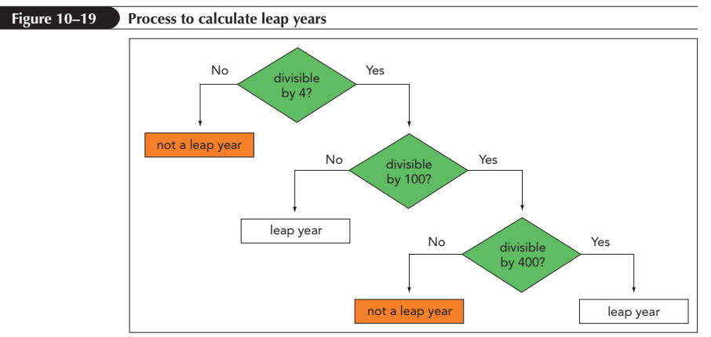
Nesting if Statements
One if statement is nested inside another

Slide 58
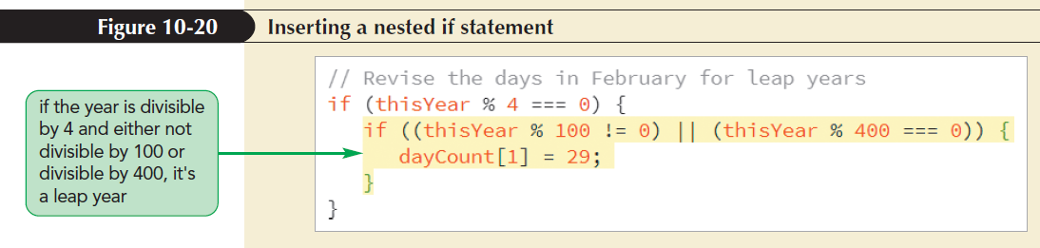
Nesting if Statements (continued)
One if statement is nested inside another

Slide 59
Exploring the if else Statement
if else statement: Chooses between alternate command blocks
It runs one command block if the conditional expression is true and a different command block if the expression is false
General structure
if (condition) {
  commands if condition is true }
  else {
  commands if condition is false }

Slide 60
Using Multiple else if Statements
Structure of an if else statement is:
  if (condition1) {
  commands1
  } else if (condition2) {
  commands2
  }...
  else {
  default commands}
  where condition 1, condition 2,… are the different conditions to be tested

Slide 61
Completing the Calendar App
The completed calendar app must do the following:
  Calculate the day of the week in which the month starts
  Write blank table cells for the days before the first day of the month
  Loop through the days of the current month, writing each date in a different table cell and starting a new table row on each Sunday

Slide 62
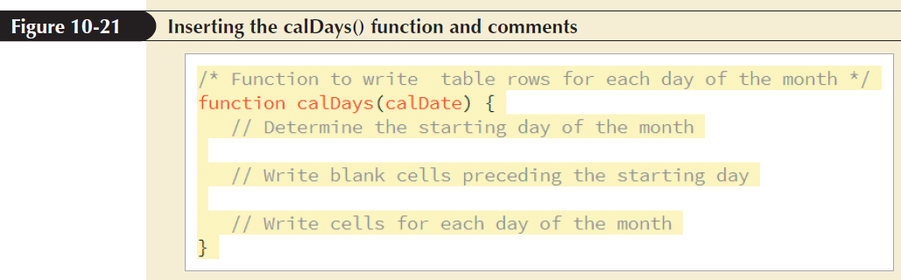
Completing the Calendar App (continued)

Slide 63
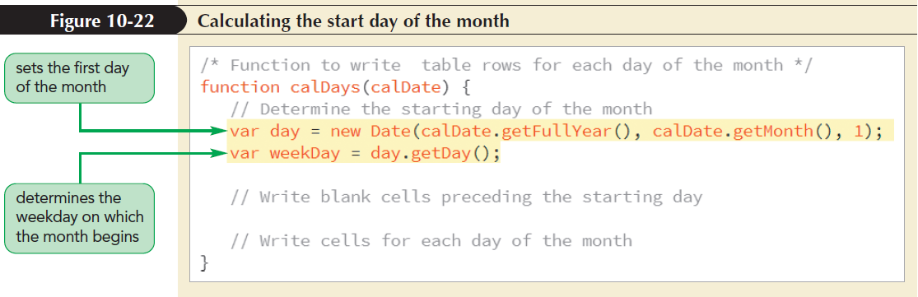
Setting the First Day of the Month

Slide 64
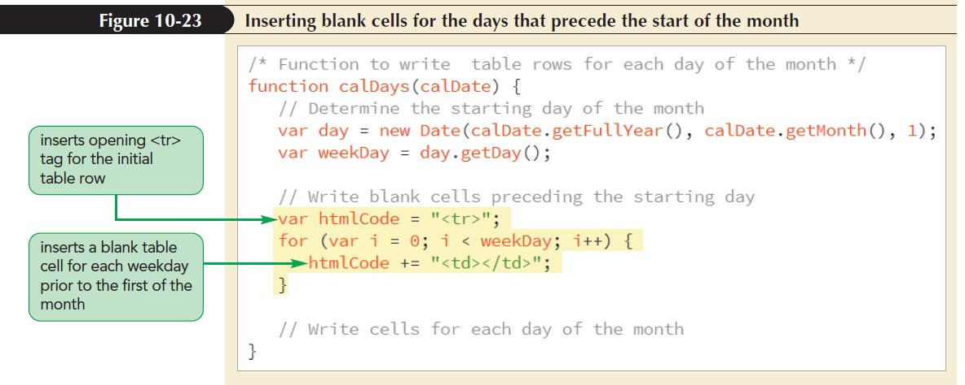
Placing the First Day of the Month

Slide 65
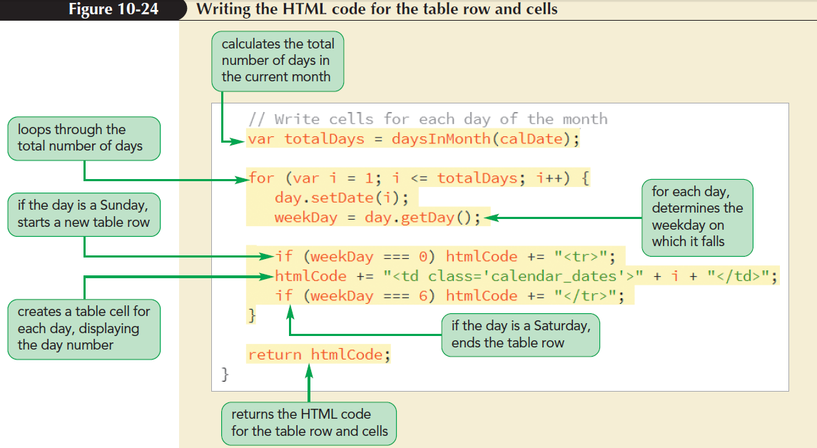
Writing the Calendar Days

Slide 66
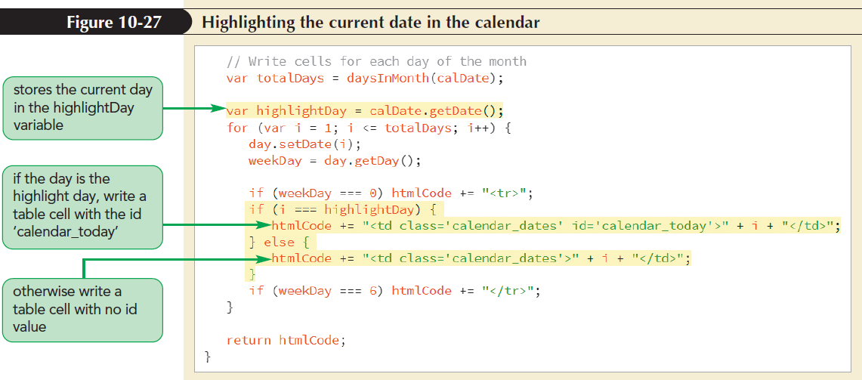
Highlighting the Current Date

Slide 67
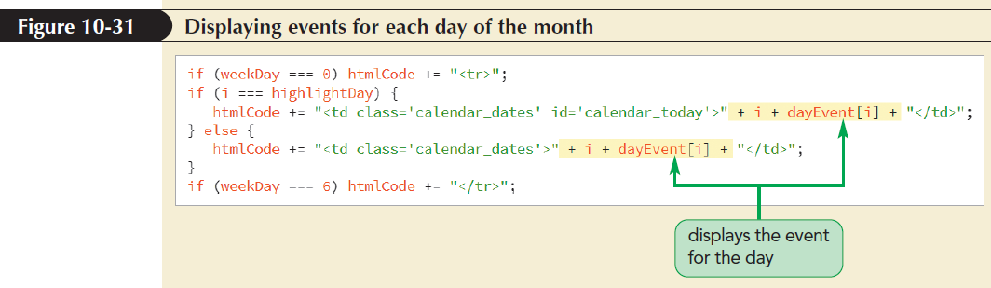
Displaying Daily Events

Slide 68
Exploring the break Command
break statement: Terminates any program loop or conditional statement
Used anywhere within the program code
When a break statement is encountered, control is passed to the statement immediately following it
It is most often used to exit a program loop before the stopping condition is met

Slide 69
Exploring the continue Command
continue statement: Stops processing the commands in the current iteration of the loop and continues on to the next iteration
It is used to jump out of the current iteration if a missing or null value is encountered

Slide 70
Exploring Statement Labels
Statement labels: Identifies statements in JavaScript code
Can be referenced elsewhere in a program
Syntax of the statement label
  label: statements
  where label is the text of the label and statements are the statements identified by the label

